Slide 1
Shapes normal
Shapes normal

Slide 2
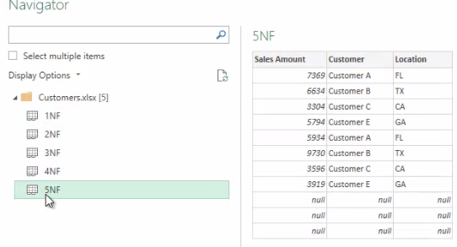
Normal forms
Note: This workshop uses the Customers.xlsx file located in the resources \Advanced Transformations folder
Customers.xlsx file into the query editor. The workbook contains five examples of normal form violations.

Slide 3
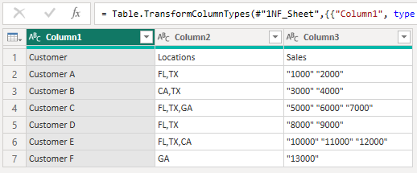
Normal forms
1NF.xlsx file
Set the first column as the header

Slide 4
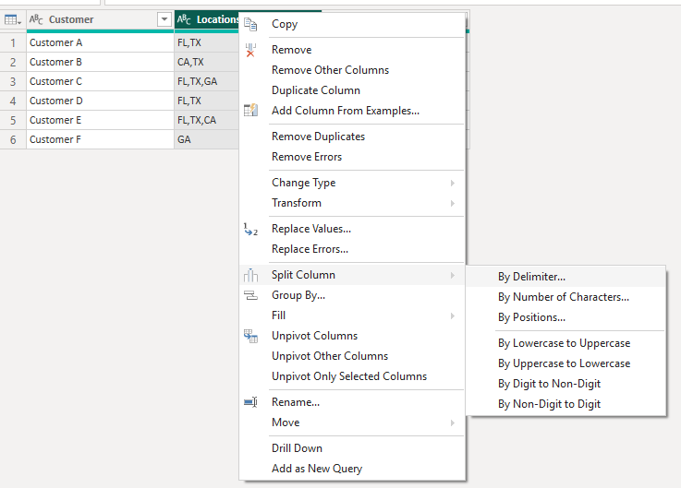
Normal forms
Start with the Locations column by performing a Split Column with the comma as the delimiter.

Slide 5
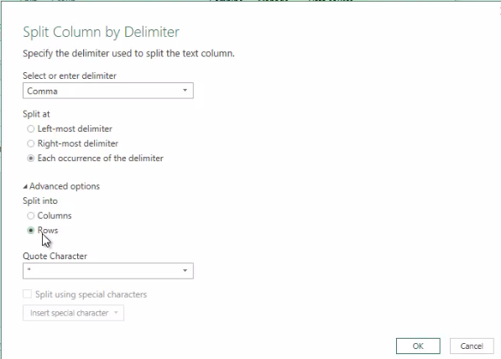
Normal forms
In the Advanced options , choose Split by row instead of Split by column .
1
2
3

Slide 6
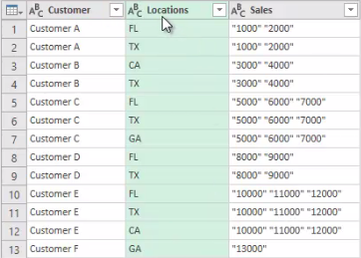
Normal forms
Check that the query has this form conforming to the first normal form ( 1NF ).

Slide 7
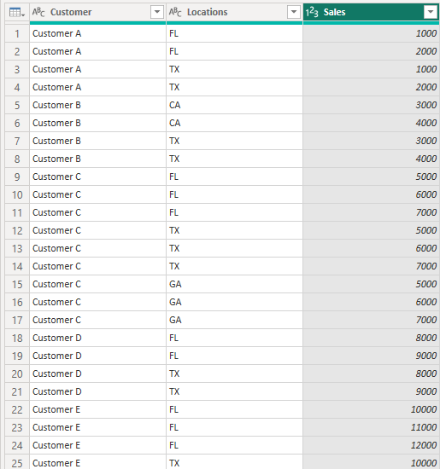
Normal forms
Perform the same split operation on the Sales column .

Slide 8
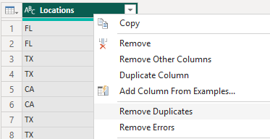
Normal forms
Now the table respects the first normal form but not the fourth normal form because the values in the Locations column and the Customers column are in duplication
Start by duplicating table 1NF and renaming it to Locations
Delete all columns except Locations
Eliminate duplications in the Locations column

Slide 9
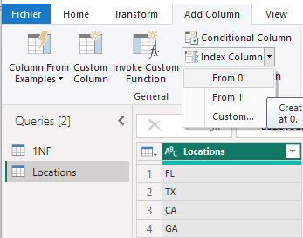
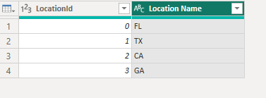
Normal forms
Add a 0-based index column and position this column at the beginning
Rename the two columns to LocationId and Location Name

Slide 10
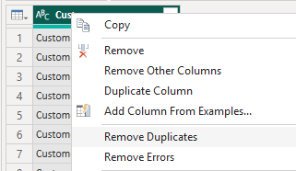
Normal forms
1NF table again and call it Customers
Delete all columns except the Customers column
Eliminate duplication in the Customers column

Slide 11
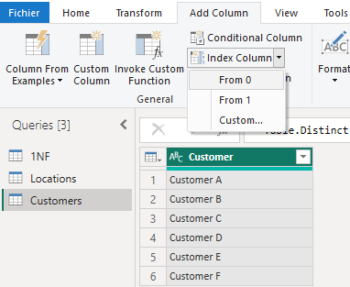
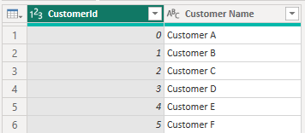
Normal forms
Add a 0-based index column
Rename the columns to CustomerId and Customer Name

Slide 12
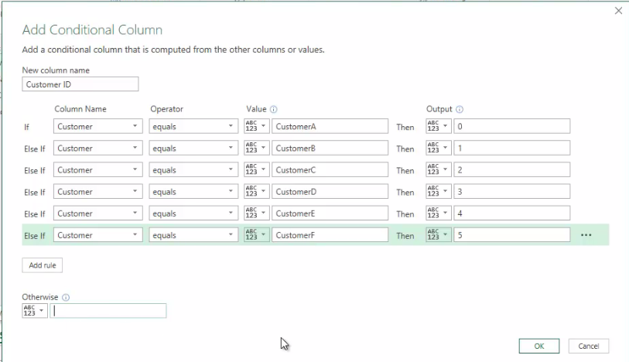
Normal forms
1NF table to Sales and add a conditional column Customer ID

Slide 13
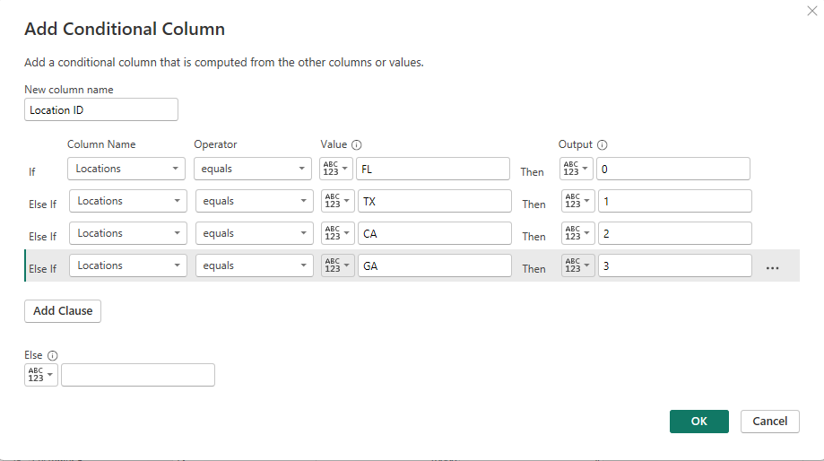
Normal forms
Add a conditional Location ID column by following the same procedure above .

Slide 14
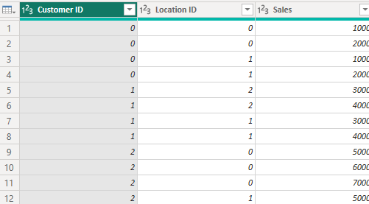
Normal forms
Remove the two Customers and Locations columns in Sales
Position the Customers ID and Location ID columns at the beginning
the Customers ID and Location ID columns is Number

Slide 15
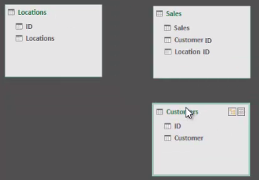
Normal forms
View tables in model space.

Slide 16
THANKS
THANKS

